Slide 1

CONCEPTUAL DESIGN PRESENTATION

Slide 2

MERT KAYIŞ COO

Slide 3
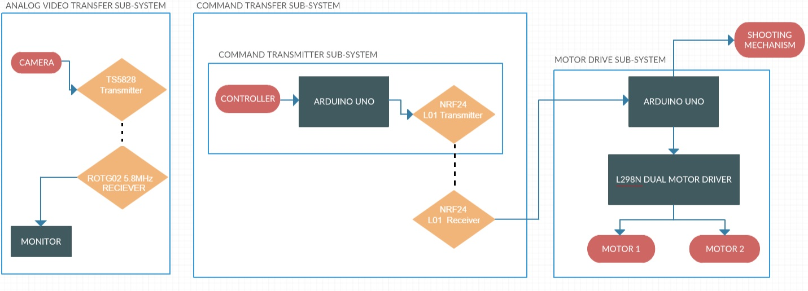
Overall Block Diagram

Slide 4
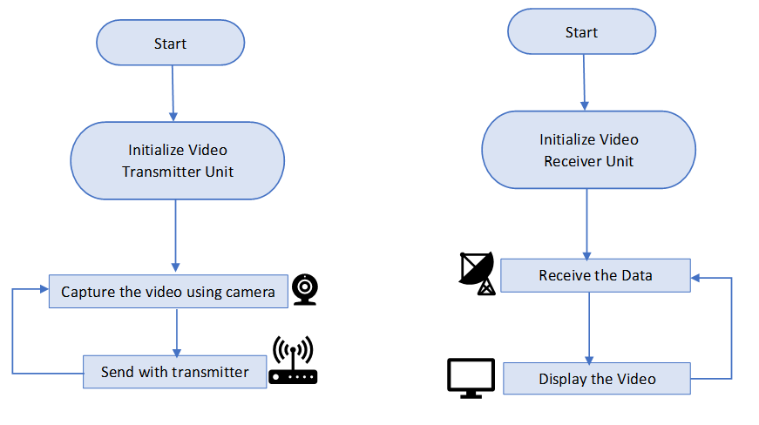
Flowchart for Video Transfer Subsystem
Continuous operation
Continuous operation

Slide 5
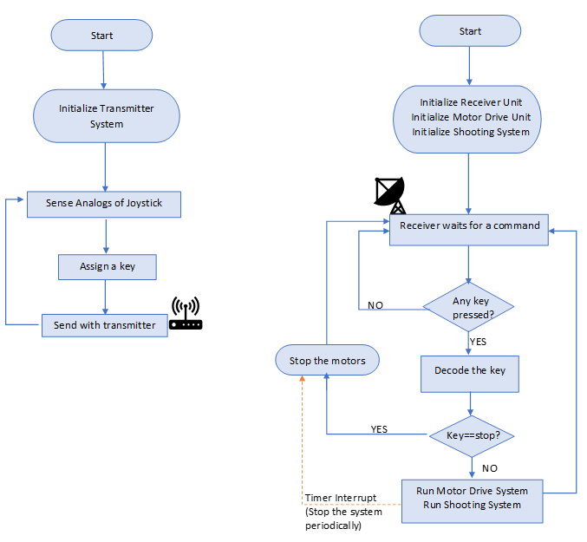
Flowchart for the Command Transfer Subsystem

Slide 6
Flowchart for the Command Transfer Subsystem

Slide 7
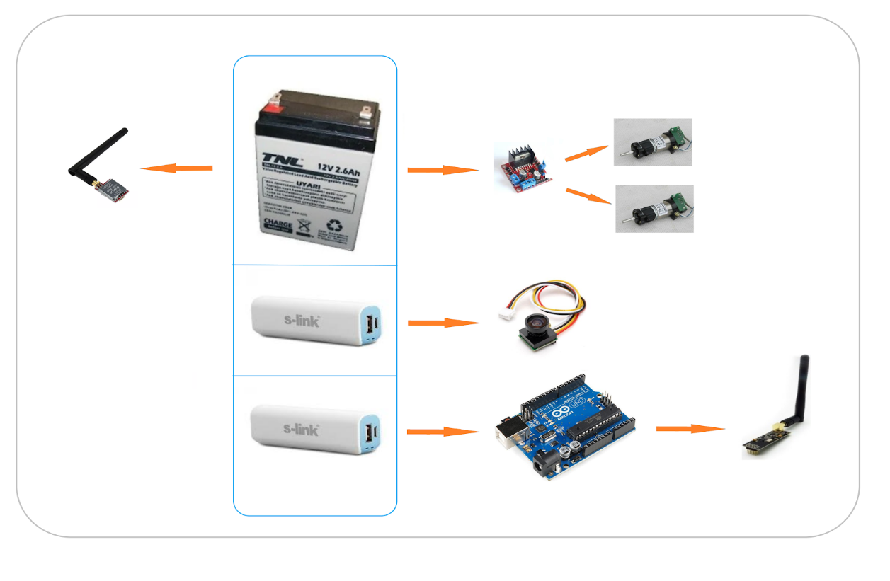
Power Supply Unit

